Slide 1
Data Science Sandbox/Platform – Sagemaker Adaption Proof of Evaluation
Preetam Balijepalli
ML Solution Architect
28/02/2020

Slide 2
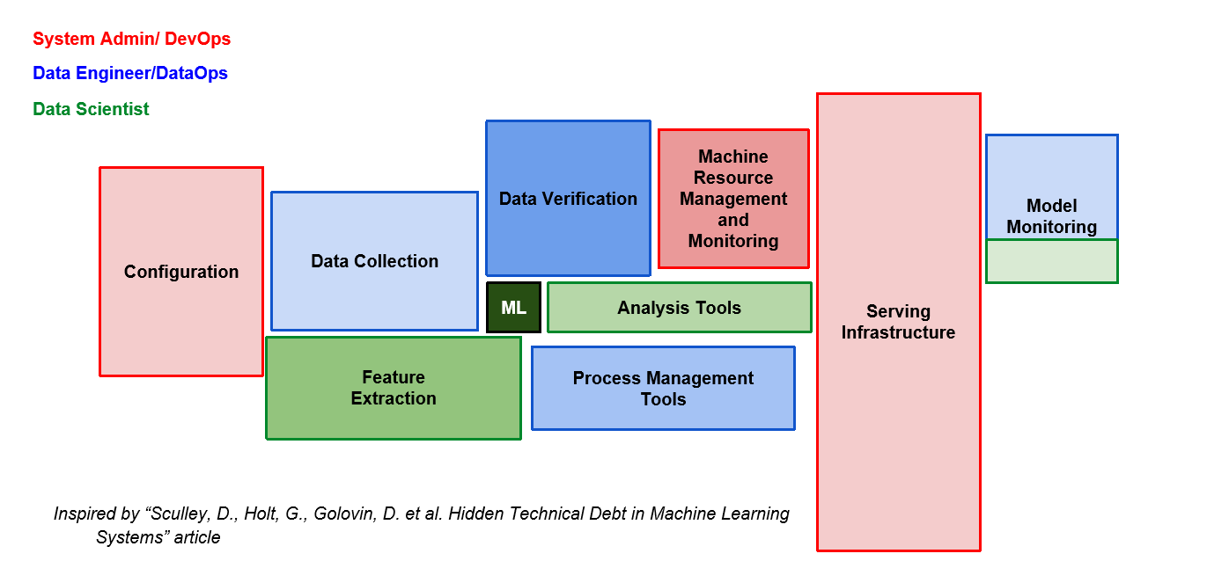
Hidden Technical Debt

Slide 3
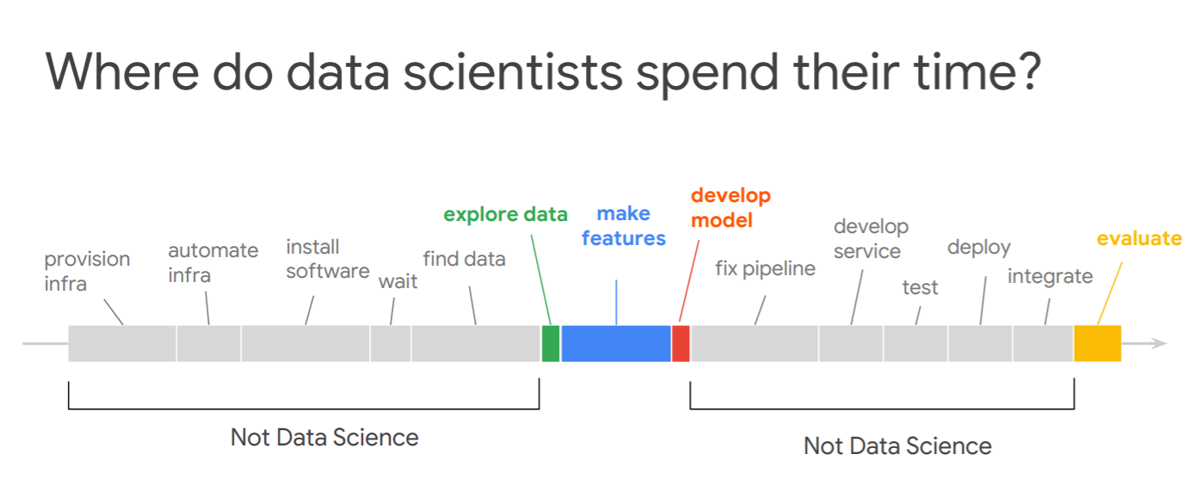

Slide 4
Benefits of using machine learning in cloud
Size of dataset
Clustered training
Hyper parameter tuning
Training / Serving Skew
De-coupling model from client
Auto scaling prediction

Slide 5
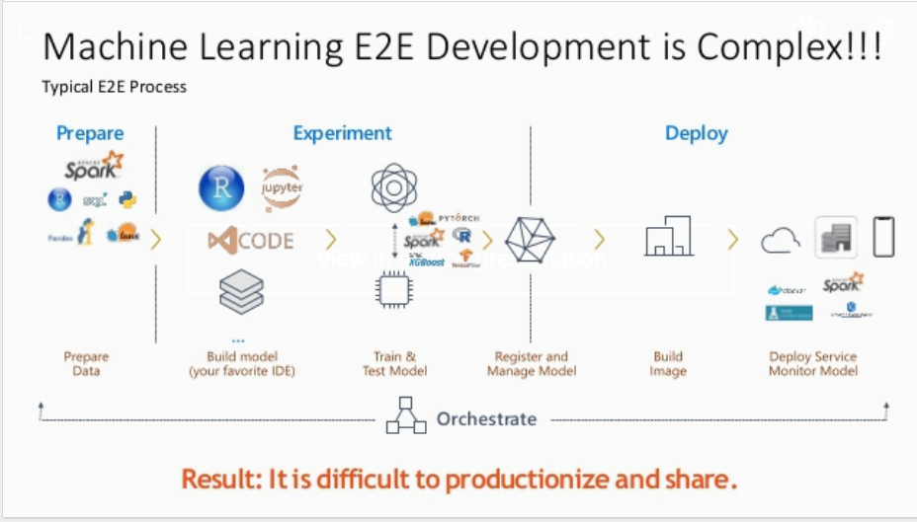


Slide 6
Why , An Intro
AWS Sagemaker

Slide 7
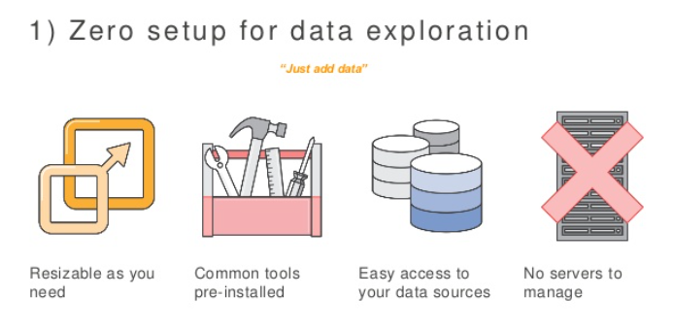
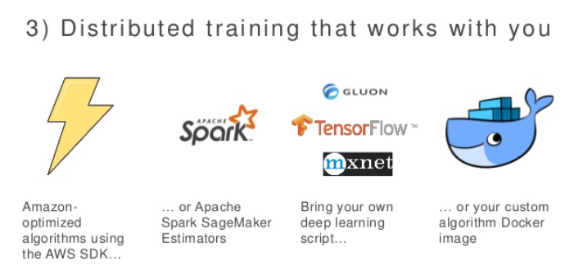
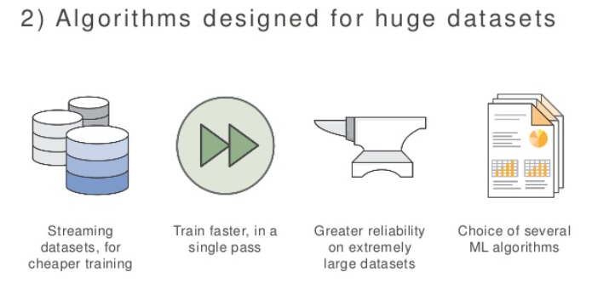
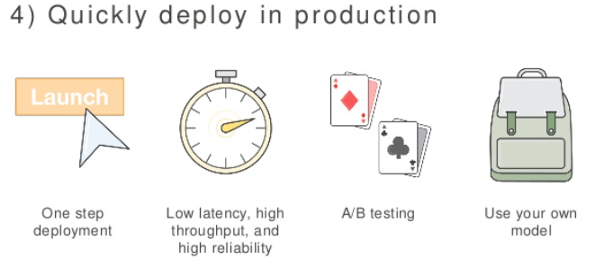
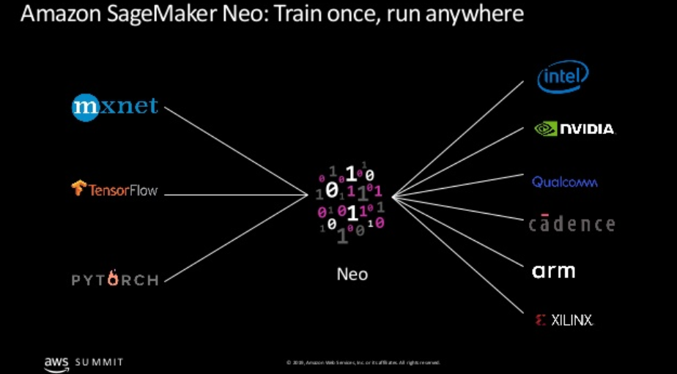

Slide 8
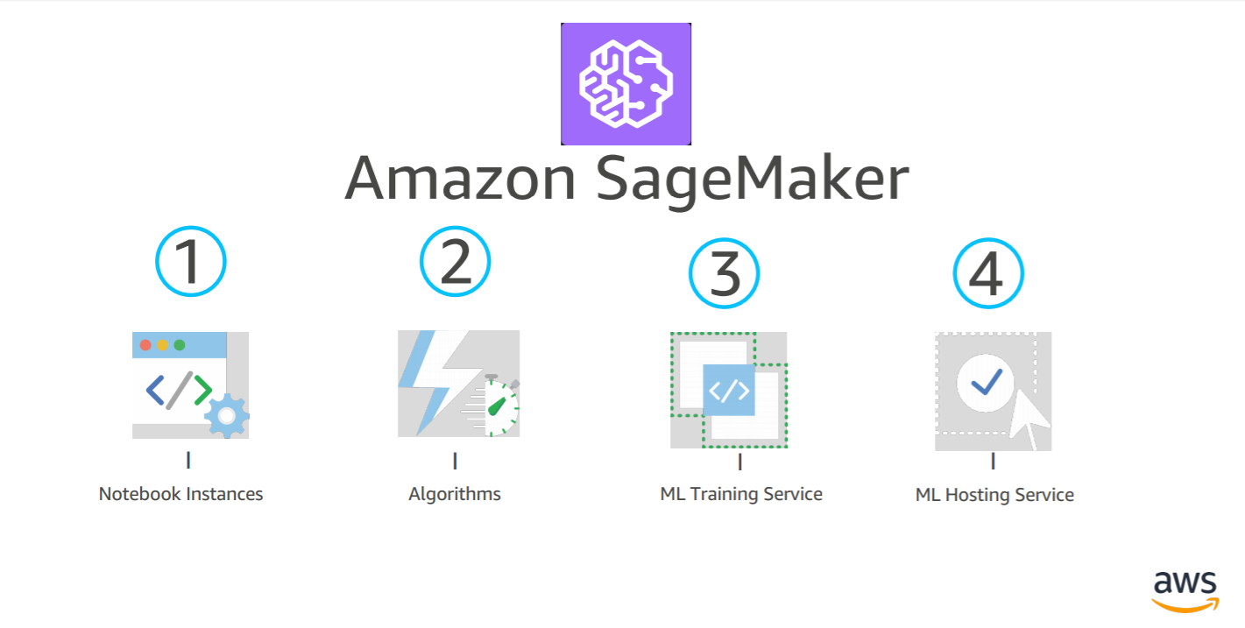
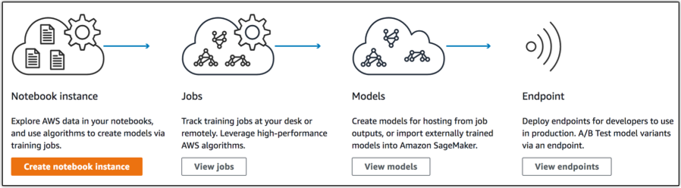
Services
A fully managed service that enables data scientists and developers to quickly and easily build machine-learning based models into production smart applications

Slide 9
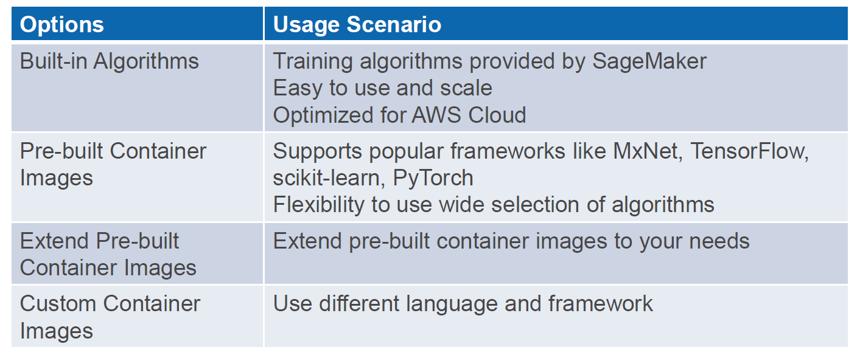
SageMaker - Training and Hosting

Slide 10
Behind the Scenes
How does it work

Slide 11
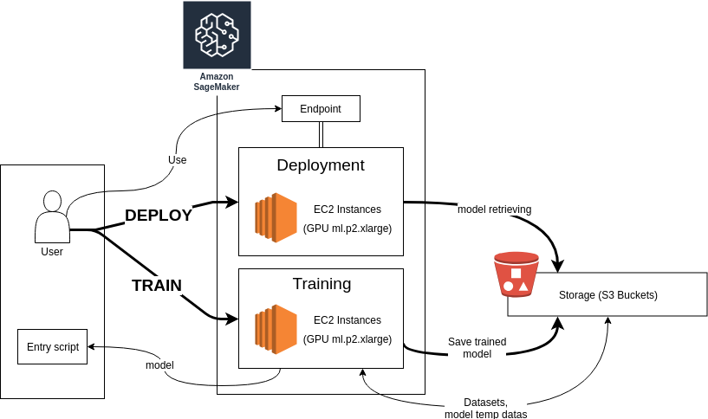
Life Cycle

Slide 12
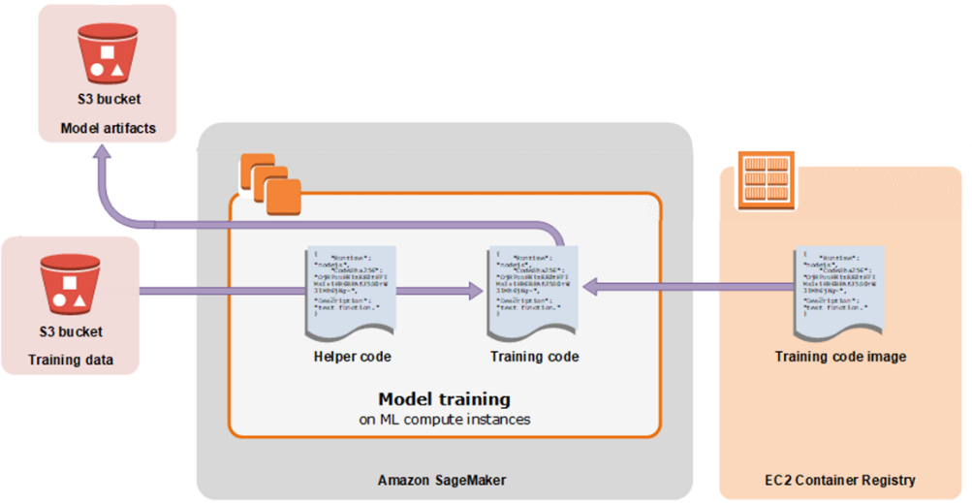
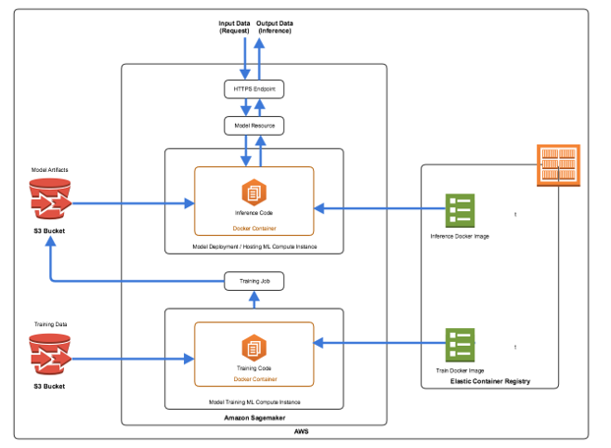
Training
Serving

Slide 13
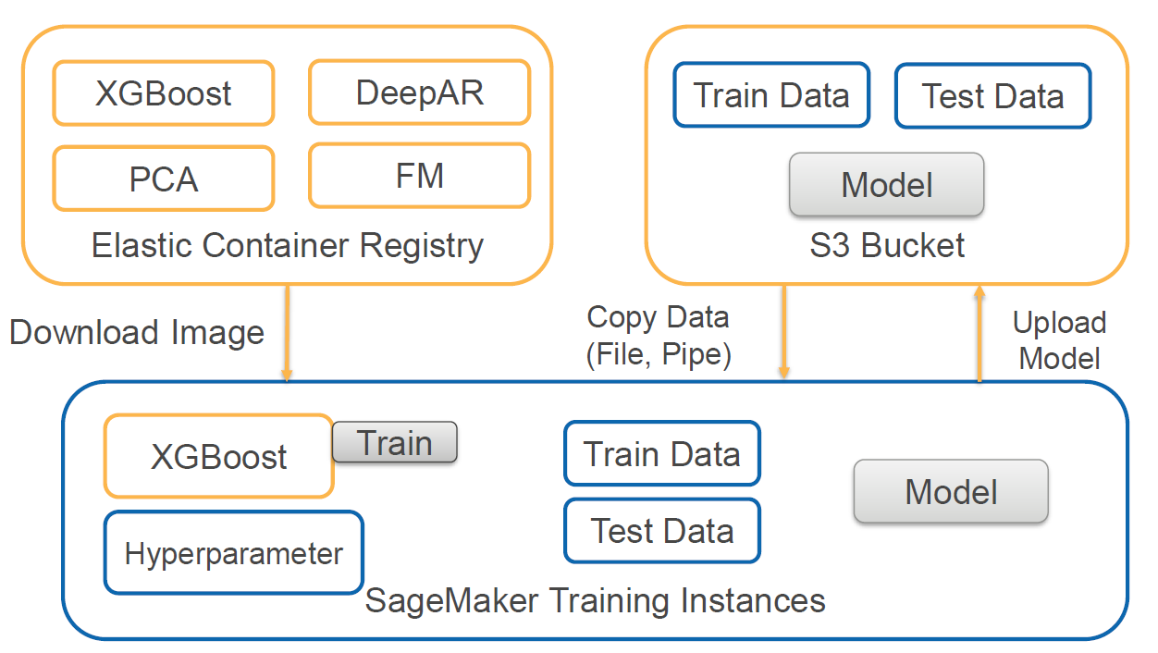
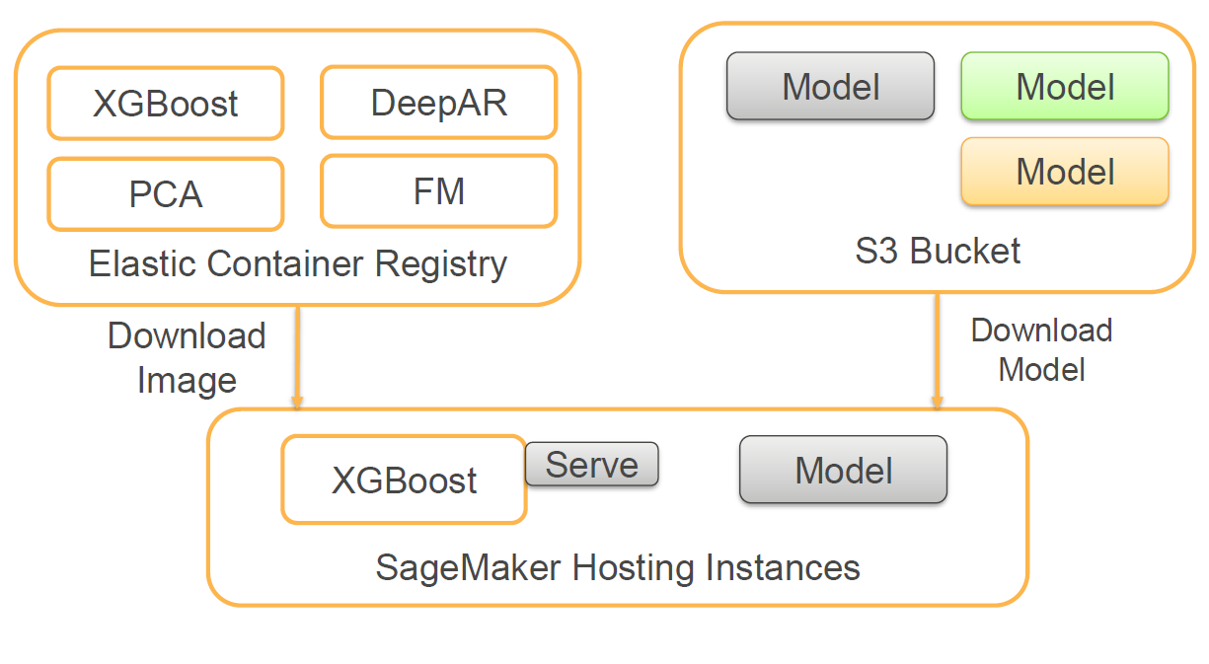
Built-in Image
Training
Hosting(Realtime , Batch)

Slide 14
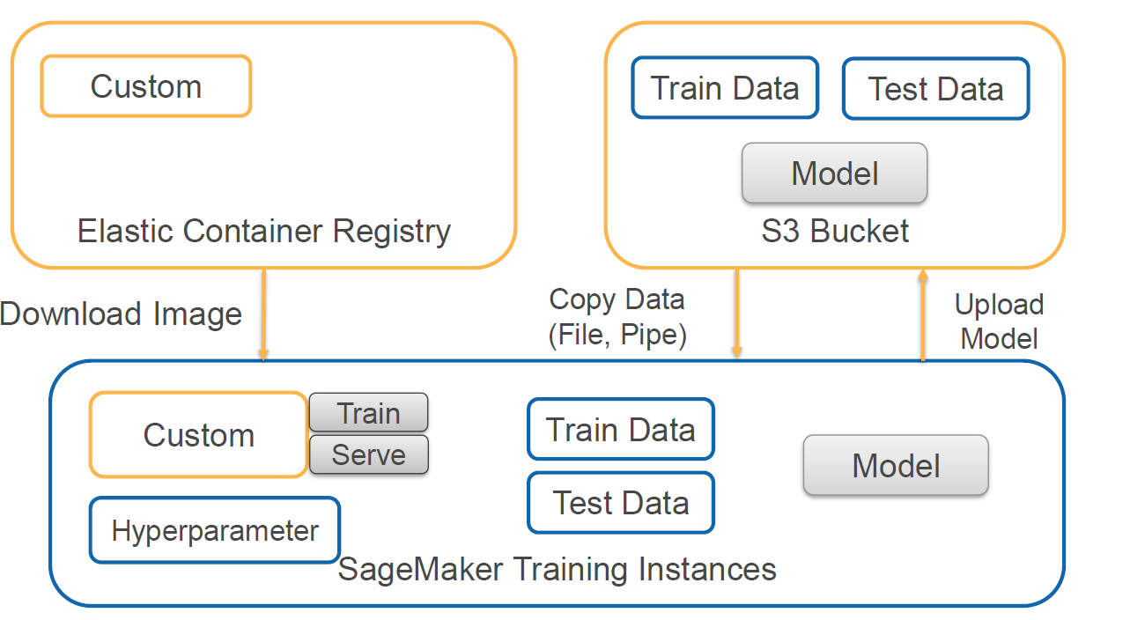
Custom Image – Training , Hosting

Slide 15
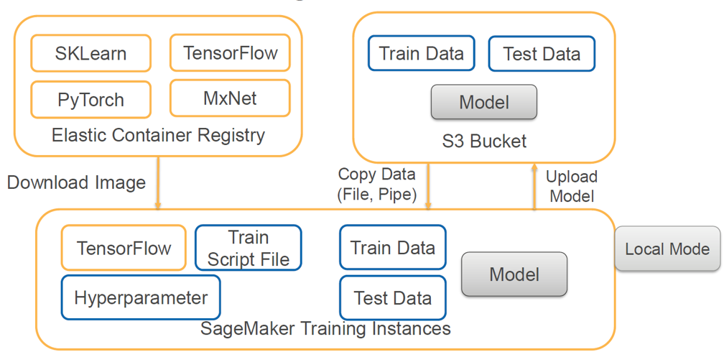
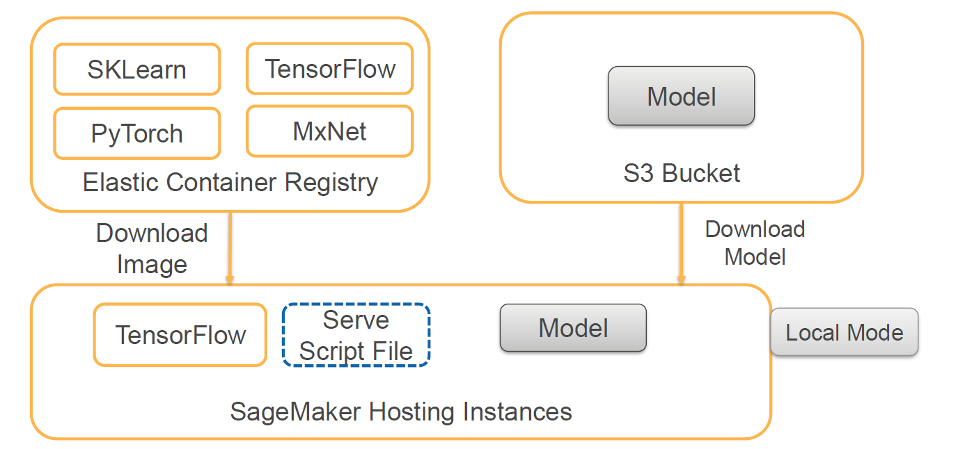
Framework
Training
Hosting

Slide 16
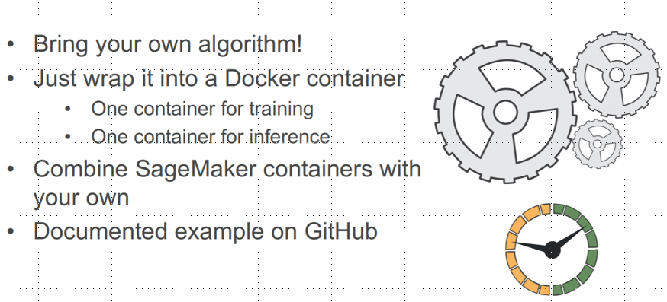
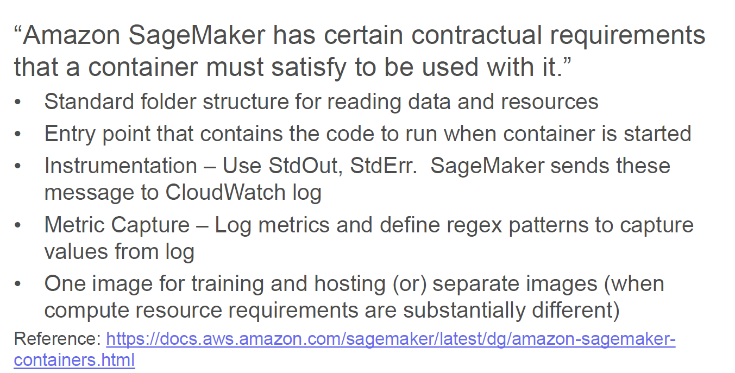
Bring Your Own Algorithm

Slide 17
Container Folder Structure

Slide 18
How its Re-inventing
AWS Sagemaker

Slide 19
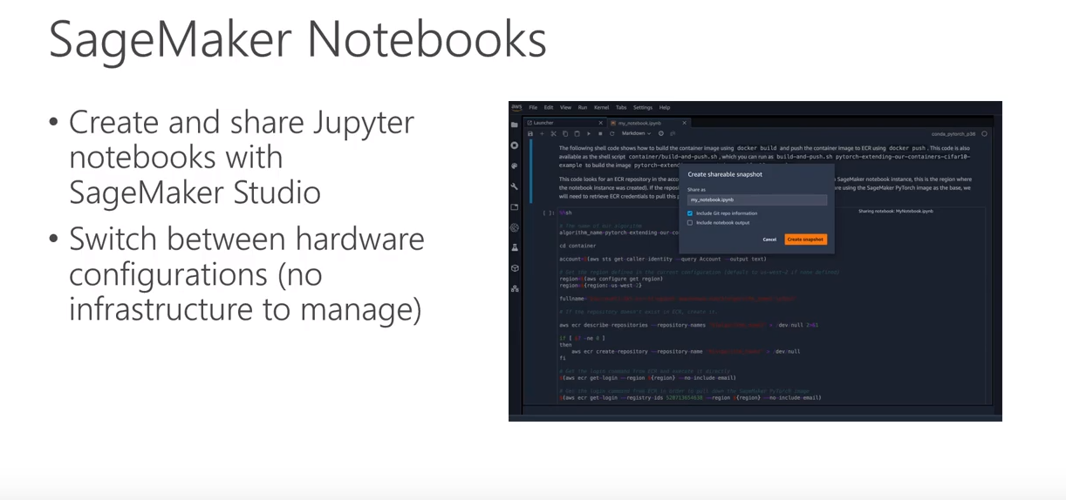
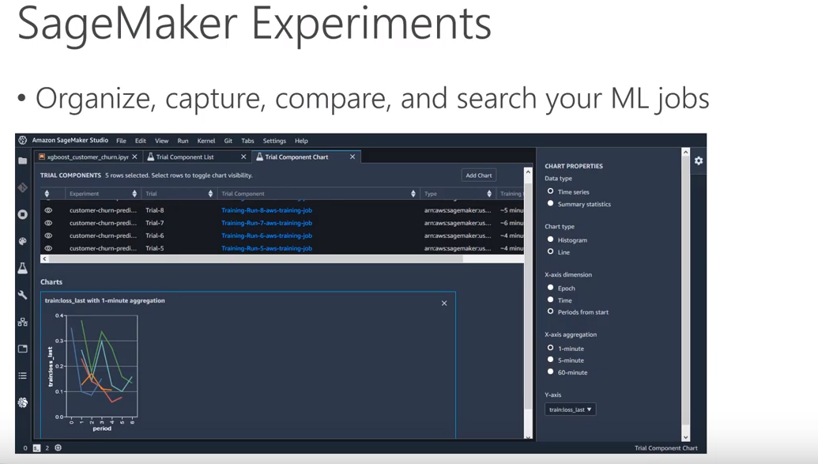
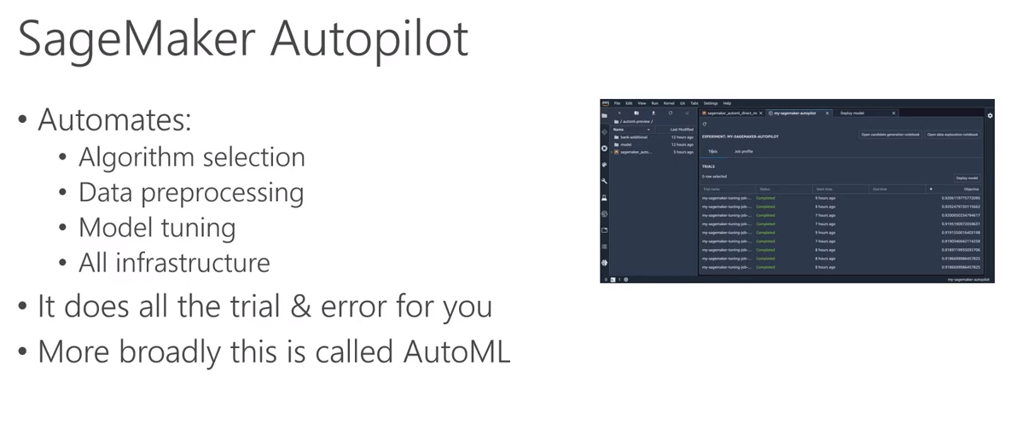
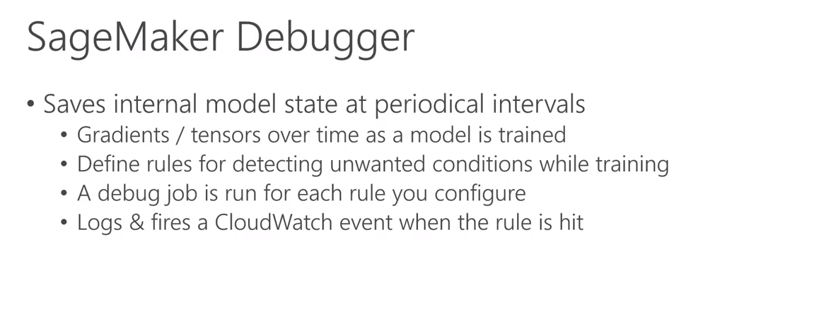
Reinvent:

Slide 20
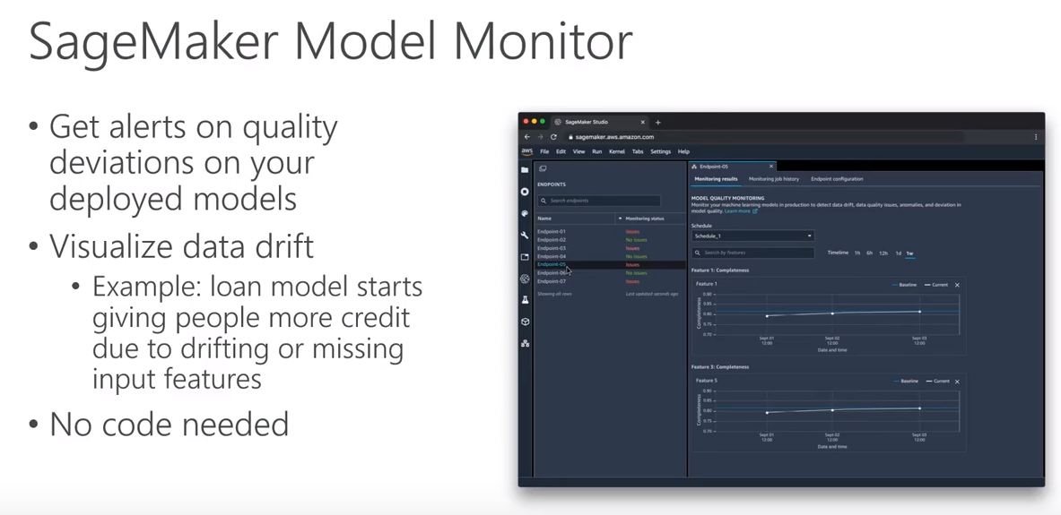
AWS Reinvent:

Slide 21
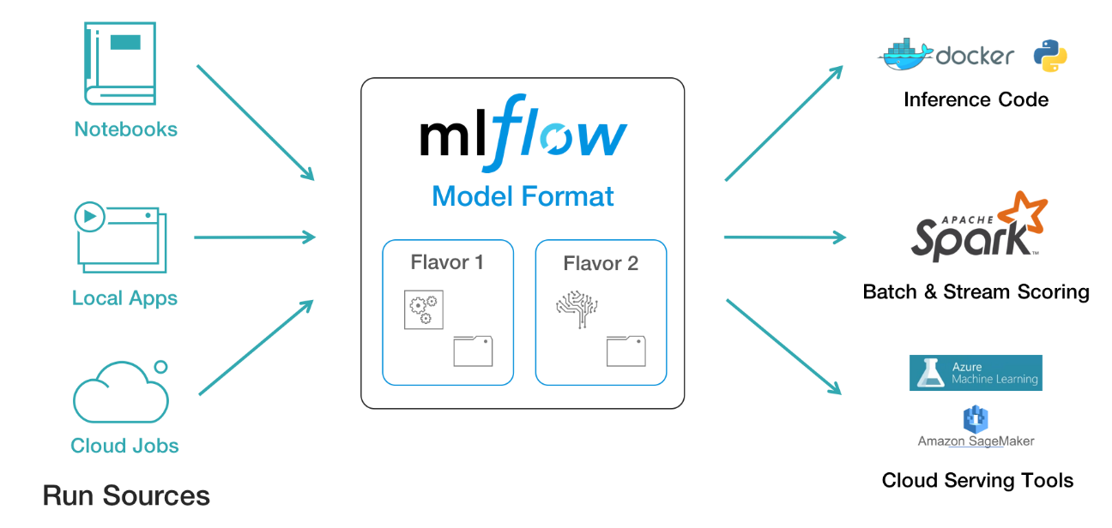
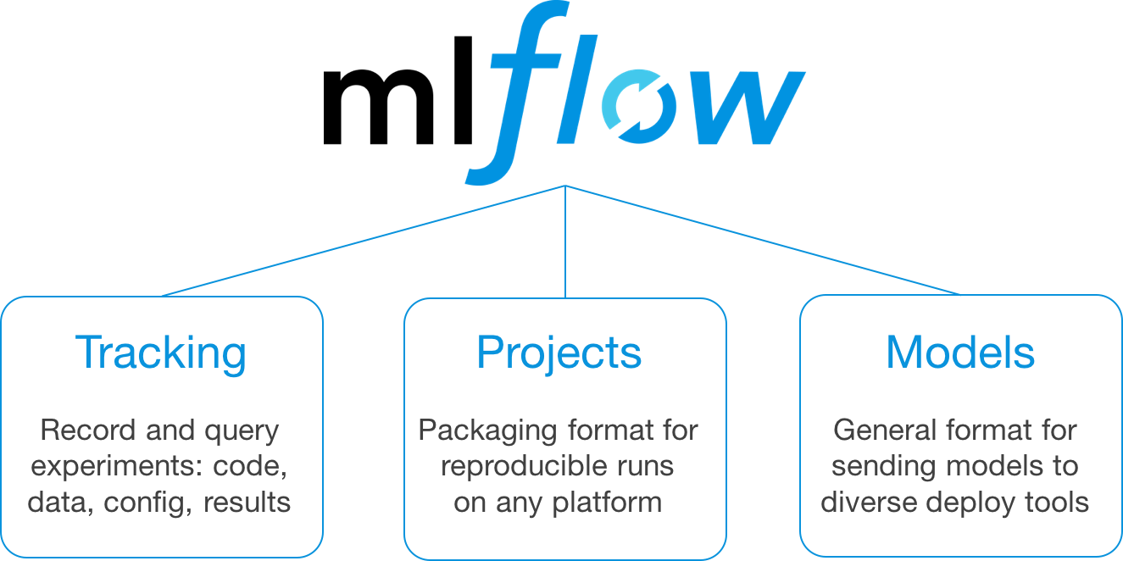
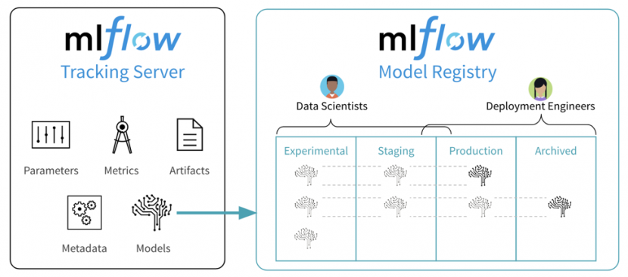
Model Lifecycle Management
Plus help us also be cloud agonistic

Slide 22
FAQ
How do we on- board user ?
Currently with the help of JIRA ticket
Can I upload my own Algorithm
Yes
Does Sagemaker Work with R ?
Sagemaker (with the help of ‘reticulate’ python package)
Apart from training and deployment , Can we also do EDA , development ?
Yes , but we are negotiating with cloud enablement team with respect to notebook
As of now we have a Jupyter hub which can talk to sagemaker services
Can I integrate with other environments like pycharm , spyder ?
Yes we need to have aws security groups , network and certificates configured for a successful handshake
How are we going to orchestrate the entire pipeline ?
We can use AWS Step + Lambda , Airflow
Does it integrate with internal code and package repository
Yes

Slide 23
Evolving Architecture : Future Plans
Enable highly regulated sagemaker access that would help in
Notebook access
Back charge the consumers requesting for the access
Other ML use cases
SageMaker Neo : new deep learning model compiler lets customers train models once, and run them anywhere
Amazon Textract : uses machine learning to instantly read virtually any type of document to accurately extract text and data without the need for any manual review or custom code
Computer Vision : can gain high-level understanding from digital images or videos
Ground Truth : offers easy access to labelers through Amazon Mechanical Turk and provides them with built-in workflows and interfaces for common labeling tasks.

Slide 24
Amazon SageMaker—Your Turn
Getting started with Amazon SageMaker: https://aws.amazon.com/sagemaker/
Use the Amazon SageMaker SDK:
For Python: https://github.com/aws/sagemaker-python-sdk
For Spark: https://github.com/aws/sagemaker-spark
For R:
https://timmastny.rbind.io/blog/aws-sagemaker-r/#aws-cost
https://www.rpubs.com/TimFlocke/SageMaker_R_demo
https://aws.amazon.com/blogs/machine-learning/using-r-with-amazon-sagemaker/
SageMaker Examples: https://github.com/awslabs/amazon-sagemakerexamples

Slide 25


Thank You !

